Slide 1
IP Paging: Make A Plan
Presented by:
Erich Bacher – Engineering Services Manager

Slide 2
Agenda
What are we going to accomplish here today?
Introductions
HBS Story
Emergency Communications Systems
Evaluating Existing Environment
Design Considerations
Implementation and Testing
Q and A
Notes:
​

Slide 3
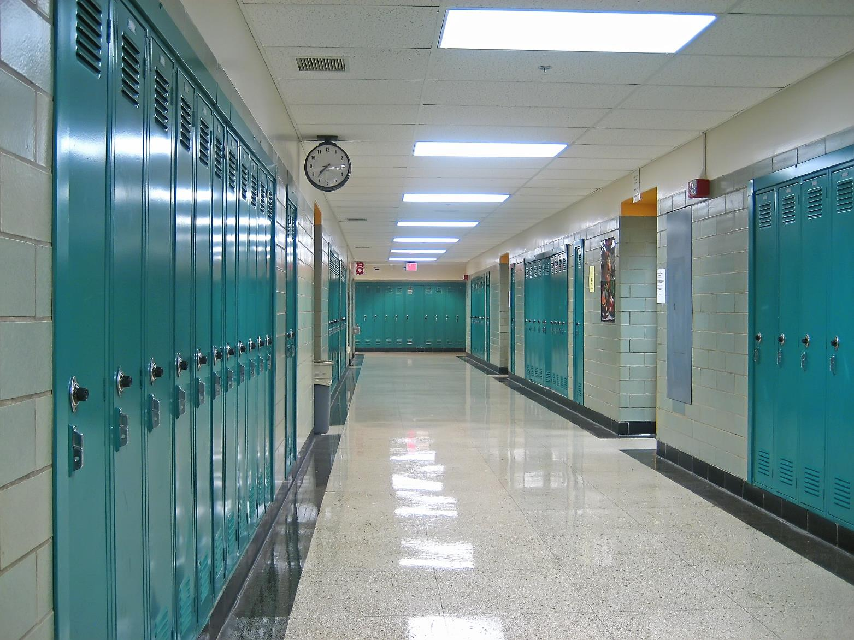
Obligatory Hallway Image
Metacommentary about presentation tropes to establish rapport with audience

Slide 4

Personal Background
Family Business
16 Years Voice Experience
Strengths in Troubleshooting and Project Management
Mitel, Cisco, Inter-tel, Panasonic, Samsung, Asterisk, 3Com
HP and Cisco Switching and Routing
Windows PC and Server
VMware
Security and Fire Alarms
Video Surveillance
Door Access
Structured Cabling
ALICE Certified
Photo Unavailable

Slide 5
Kari’s Law
Ray Baum’s Act
Kari’s Law applies to multi-line telephone systems (“MLTS”) installed” after
the compliance date of February 16, 2020. It requires:
REQUIRING A “PREFIX” WHEN CALLING 911:
Locations with MLTS must be able to dial 911 without an 8, 9 or other prefix.
ON-SITE NOTIFICATIONS:
When a 911 call is placed from an MLTS, a notification must be sent to on-site personnel, alerting them to the emergency. This can take the form of phone calls, visual alerts on a monitor, audible alarms, text messages, and/or emails.
RAY BAUM’s Act requires the FCC to consider rules to ensure that MLTS systems convey dispatchable address (defined as: “the street address of the calling party, and additional information such as room number, or similar information necessary to adequately identify the location of the calling party”) to public safety with a 911 call.
On August 2, 2019 the FCC released its Report and Order that adopted such rules and concluded its proceeding as directed by Section 506.
What does section 506 of RAY BAUM’s Act cover?
RAY BAUM’s Act requires that organizations with MLTS provide dispatchable location, i.e., street address, floor, room and/or suite number (if applicable) to public safety with 911 calls.

Slide 6
E911 Changes
Requirements In Effect Now – Kari’s Law
  Simply Dial 911
  Notify Onsite Staff
Requirements In Effect Soon™ – Ray Baum’s
  Provide Specific “Dispatchable” Location
  Analog telephone lines may not be adequate to meet requirements

Slide 7

HBS
is a technology solutions provider specializing in information technology services. With 9 locations in the Midwest, HBS serves enterprise, public sector, and small and medium business with information technology services that provide business outcomes for our clients.

Slide 8



Exceptional Value
Technology solutions aligned clients’ businesses
Our Clients
HBS intimacy with client's business. Vertical Focus – Public Sector, Commercial, SMB
Our People & Partners
The very best the in the industry.
Deliver exceptional value
to our clients through our great people and partners
Notes:
We want to deliver and exceptional experience to our clients with our great people and partners.

Slide 9




Our Proud History…
Welcome Applications Team
The World Wide Web proved the need for custom programming, website development and
business intelligence.
Expansion
HBS opens offices in Minnesota and Iowa. We add Cloud, Managed Services, Imaging Services, Cybersecurity and Physical Security to our
menu of services.
1990
2004
2005-2013
2018
2014-2017
Heartland is Born
Alferi Communications provided labels to the grocery industry. Need for technology led to the creation of
Heartland Business Systems.
Growth
Heartland continues to expand by acquiring 10 companies and opens offices in Lisle, Illinois and Milwaukee, Wisconsin. We added Mitel and AV to our menu of services.
Present Day
Heartland has 9 locations throughout the Midwest,
175+ Technical Professionals with over
500 industry certifications.
Notes:
And over the years HBS has continued to invest in our client partnerships by growing our services portfolio and our footprint to continue to bring more value to our clients.

Slide 10


Who is HBS?:
Minneapolis
Eau Claire
Appleton
Madison
Milwaukee
Omaha
Des Moines
Chicago
Iowa City
600+ Employees Proudly Serving The Midwest
With a remarkable 25-year reputation with an unmatched service capability
Notes:
Today we offer the ability to serve our client in 9 locations and over 600 employees proudly partnering with clients throughout the Midwest with a remarkable 29 year history and an unmatched service capability.

Slide 11
Emergency Communications
Systems

Slide 12
Emergency Communication Systems
Support one-way and two-way flow of emergency information
Commonly designed to convey over multiple media
Composed of input devices, sensors, and output devices
Handles both individual and group communications

Slide 13
Emergency Communication Systems
An Effective ECS Should Be:
Timely - Information must be able to reach entire audience quickly
Easy to Use - Emergencies make it difficult to remember instructions
Interoperable - Must work well within ecosystem of current and future systems
Multipath - Redundant methods of contact ensure audience is reached
Resilient - Must continue to operate under adverse conditions

Slide 14
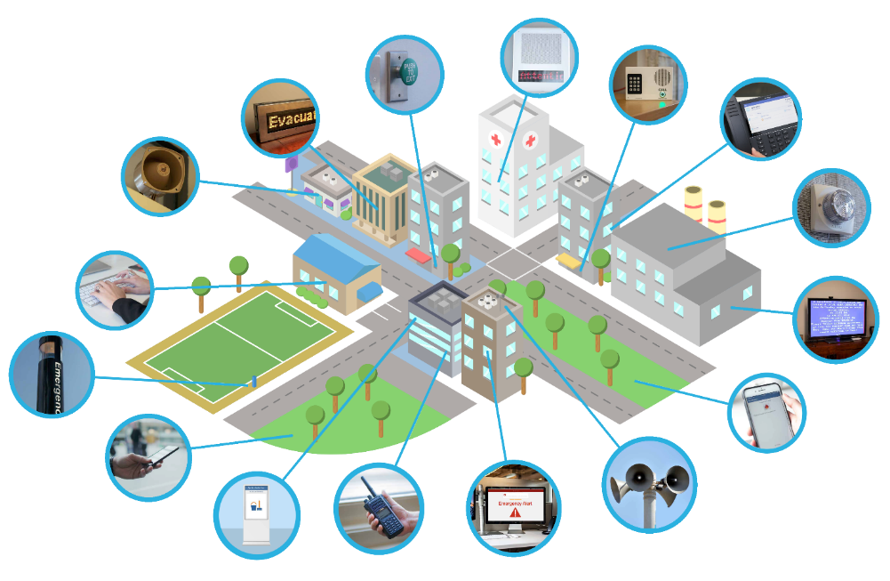
Emergency Communication Systems
IP Speakers / PA Systems
GPIO Contact Closures
Gate/Door Entry Buttons
LED Displays
Analog Systems
IP Phones
Strobes & Beacons
Email Alerts
CCTV Override
Emergency Phones
Mobile Devices
SMS Messaging
Outdoor Loudspeakers
Digital Signs
Mobile Radio
Desktop Notifications

Slide 15
Evaluating the Existing Environment

Slide 16
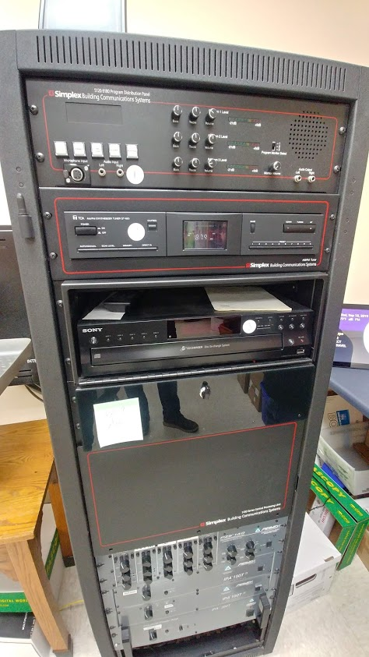
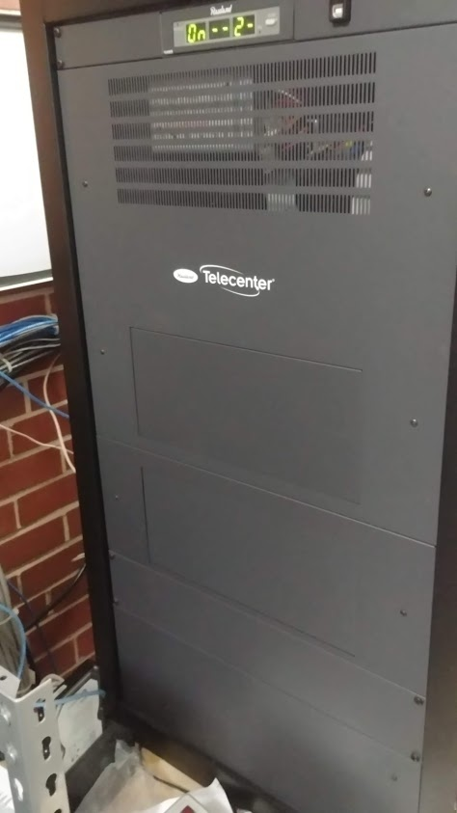
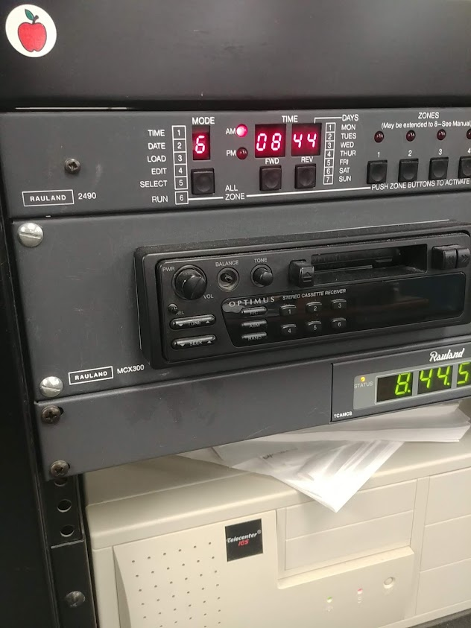
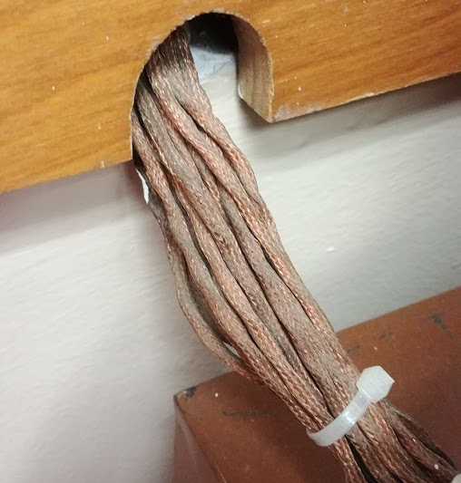
The Legacy

Slide 17
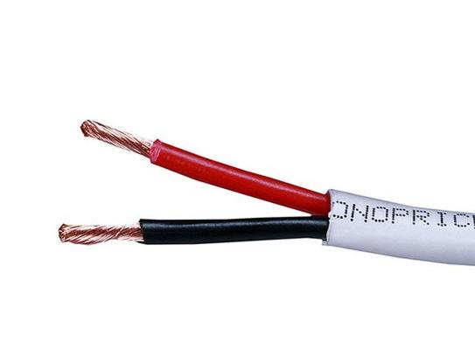
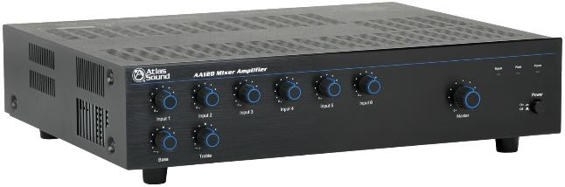
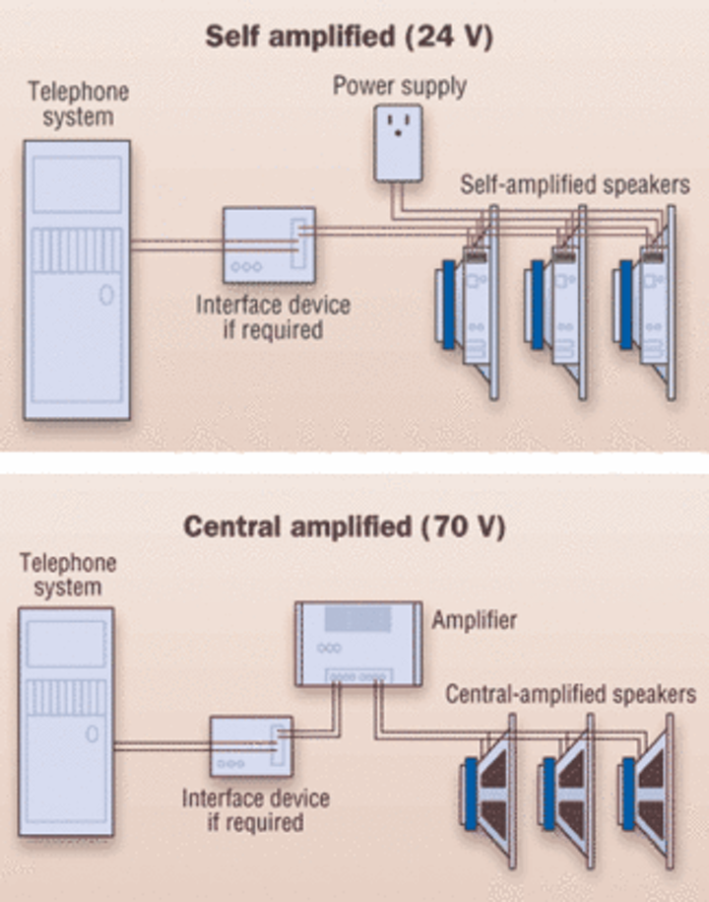
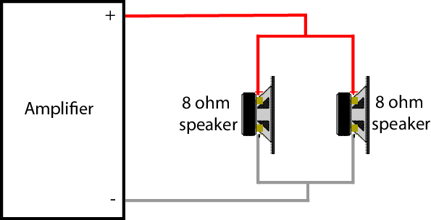
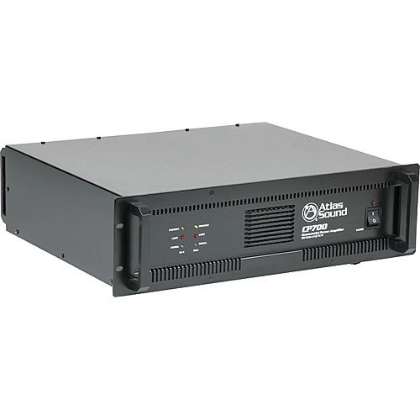
Analog Paging - One Way, Centrally Amplified
25v or 70v are most common
Each zone is a single shared cable run.
Combined Speaker Wattage <= Amplifier Output Rating

Slide 18
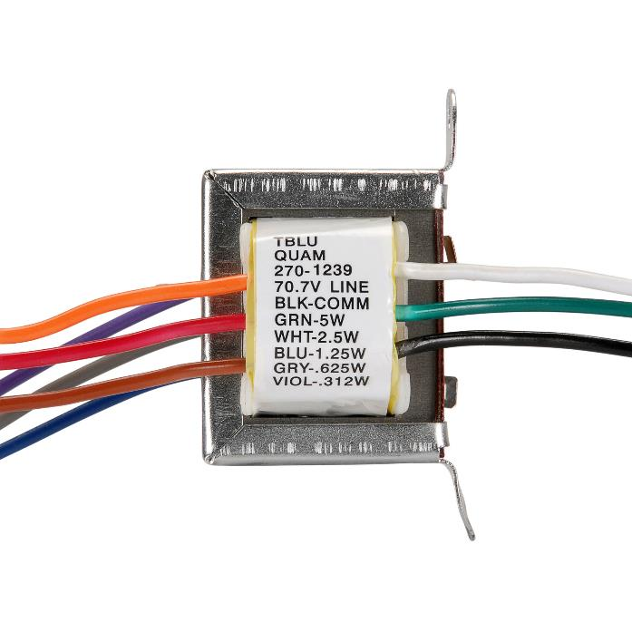
Analog Paging - One Way, Centrally Amplified
1.25w
2.5w
2.5w
Individual speakers can be “tapped” at different levels
Volume adjustments require an engineer to rewire

Slide 19
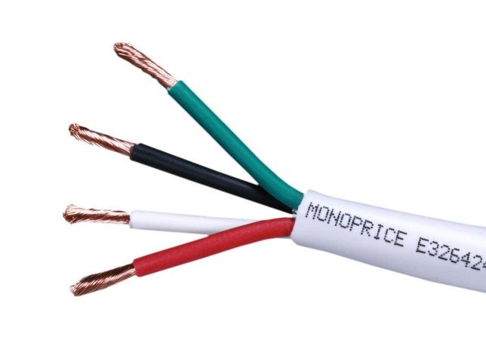
Analog Paging - One Way, Self Amplified
Most often 24v
Each zone is a single shared cable run.
Volume adjustments can be made at the device with a dial

Slide 20

Analog Speakers - Talkback
Talkback Control Unit
25v and 45-ohm speakers are most common
Audio only uses one pair, similar to a phone line
Each speaker is its own zone and an individual cable run to the control equipment, not a parallel or daisy-chain
Provides live audio monitoring of the area during an emergency situation.

Slide 21
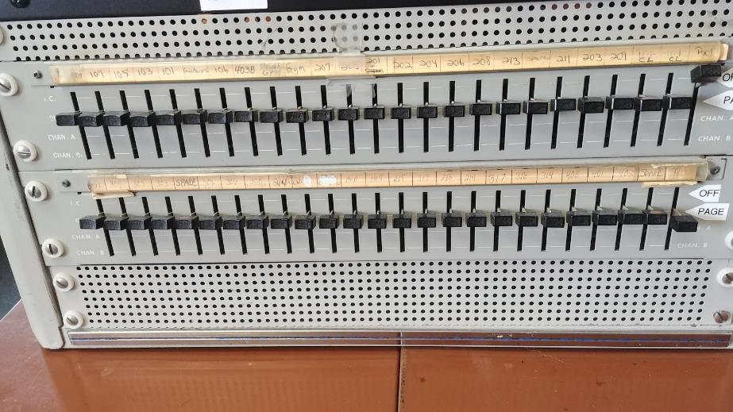
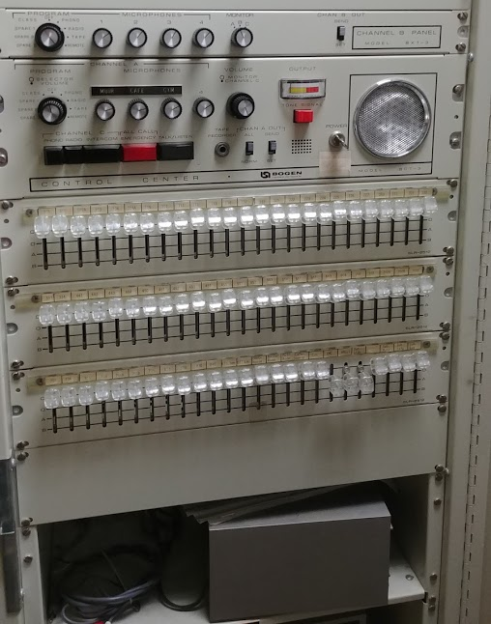
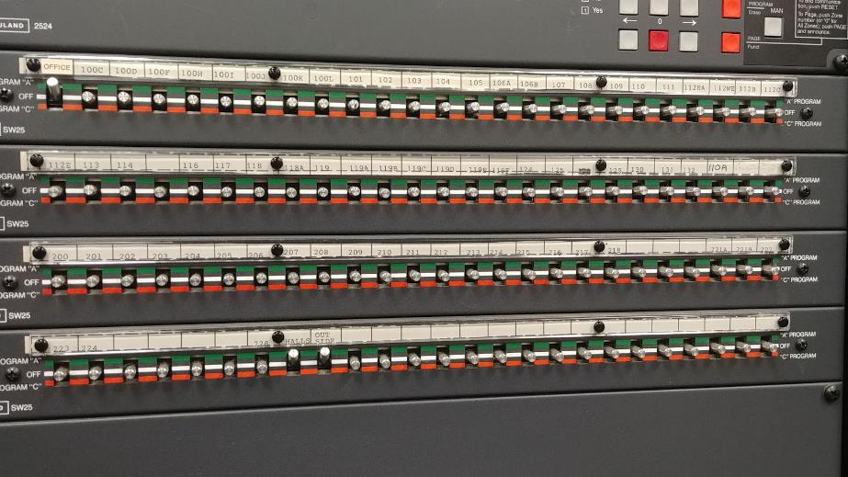
Analog Paging – Talkback Switch Panels

Slide 22
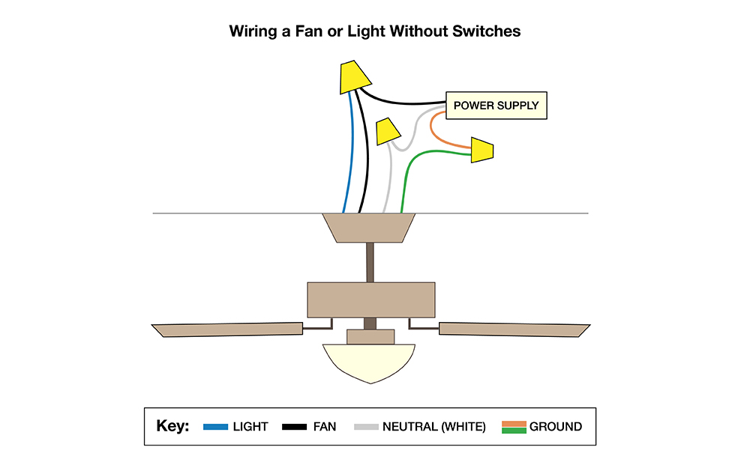
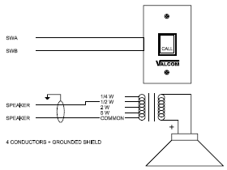
Analog Speakers – Talkback Wiring

Slide 23
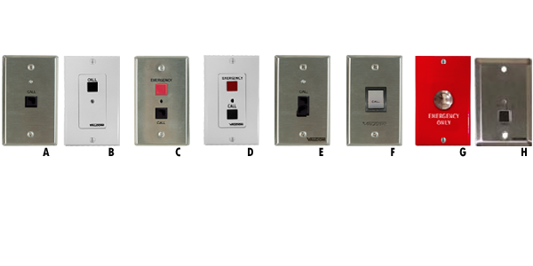
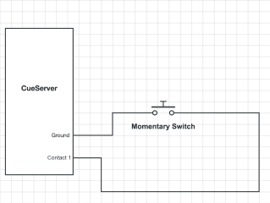
Analog Speakers – Call Buttons

Slide 24
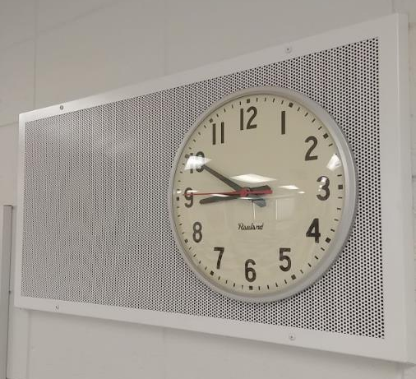
Wait, what about that clock?

Slide 25
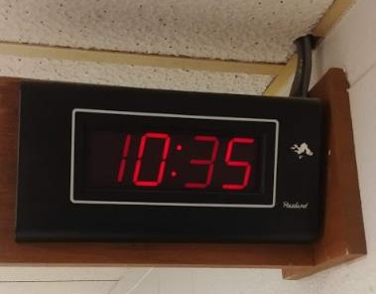
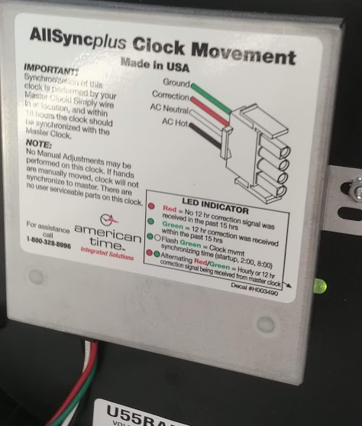
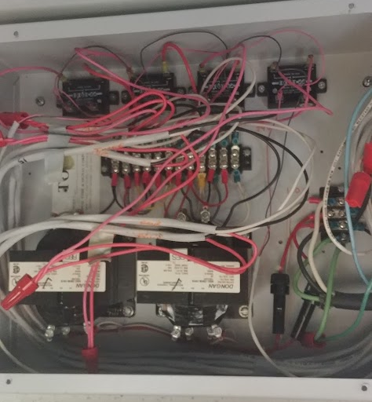
Wired Synchronized Clocks
12v, 24v, or 110v are most common
Clocks share single cable run, for the most part
Synchronization is handled by tightly timed voltage application between leads.
Each manufacturer has its own standard, but there is some inter-brand compatibility

Slide 26
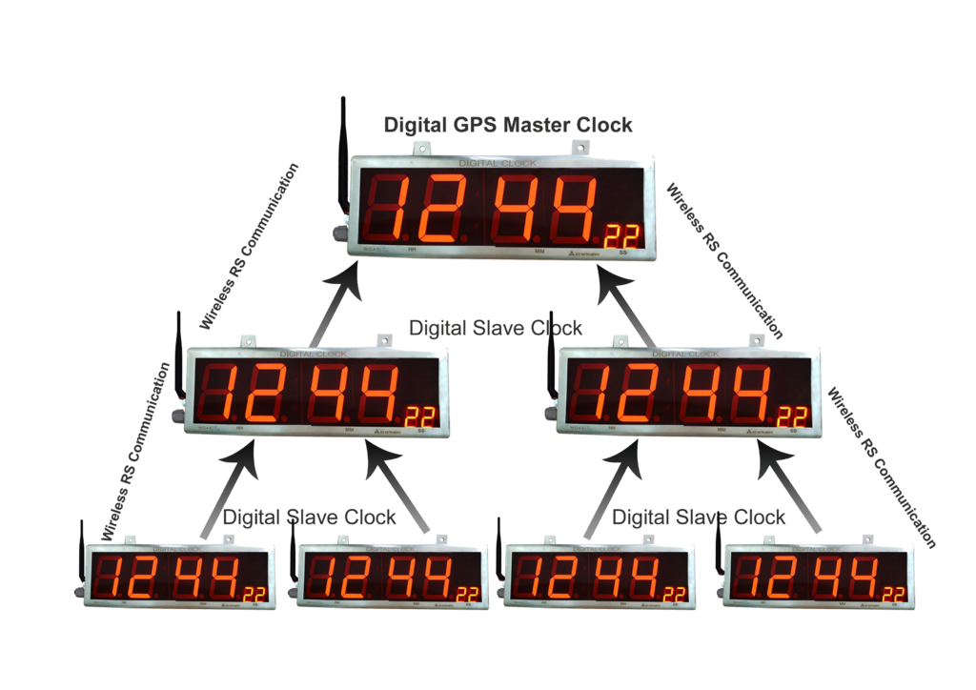
Wireless Synchronized Clocks
12v, 24v, or 110v are most common to power the devices
Battery powered options
Sync signaling is mostly proprietary, with little inter-brand compatibility

Slide 27
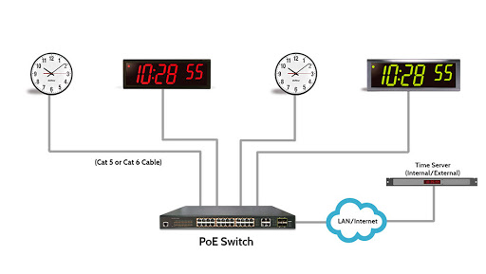

IP POE Clocks
Powered by switching, each device independently able to get NTP.
Completely standards-based.
Only downside is cost.

Slide 28
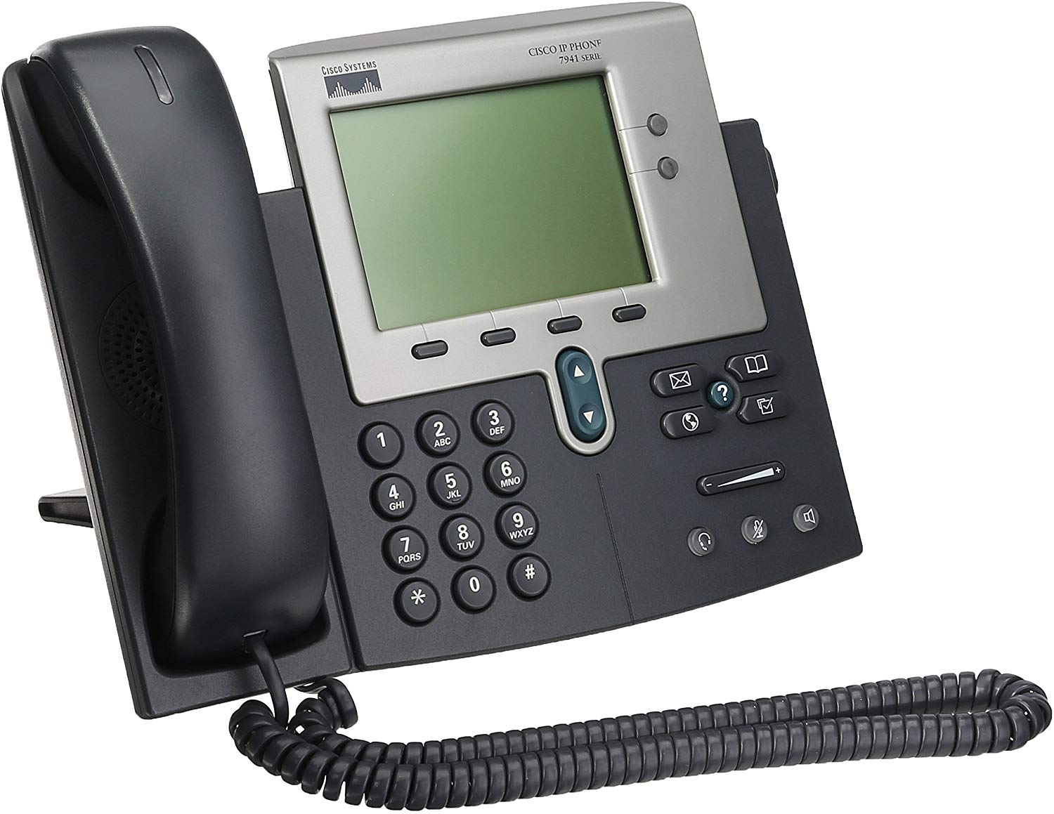
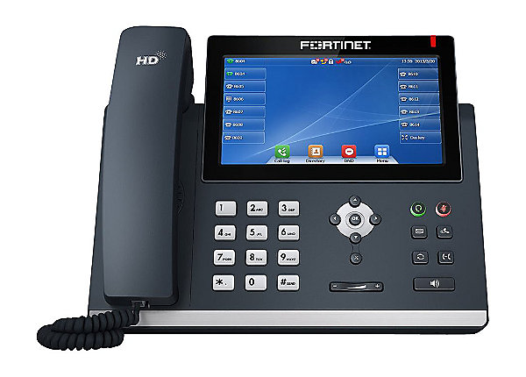
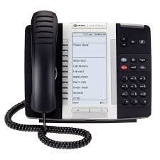
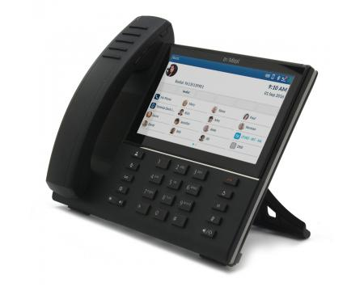
We Can Just Page Over Our Phones
Many phones don’t interrupt a call in-progress to receive a page
Phones aren’t placed in proper locations or loud enough
Many phone systems can’t page to all phones simultaneously
Ceiling Speaker
No, You Can’t.
We Don’t Recommend It
Phone Speaker

Slide 29
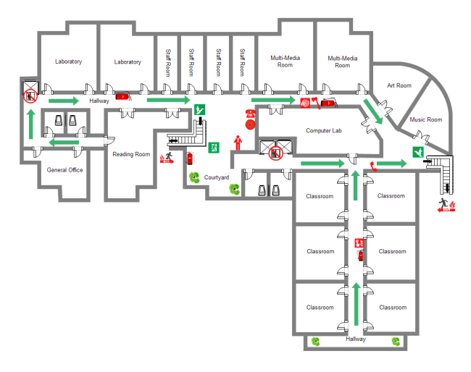
Where Are The Speakers?
* and clocks
Inventory each device, uniquely identify by room number
HS-101-1
Note which IDF/MDF is closest
Solicit feedback from staff about nonfunctional speakers or areas of low sound
Keep an eye out for intentionally disabled speakers. Rag stuffed into horn casing, etc.
Does the speaker in place meet the needs of the environment?

Slide 30
Design Considerations

Slide 31
Where Should There Be Speakers?
We recommend providing clear, audible coverage to any room that is a teaching space, has students in it during the day, or any room where staff may be working in relative isolation.
Consider:
Restrooms
Stairways
Practice Rooms for Band and Choir – soundproofed?
Special Activity Rooms
Coaching areas and offices
Garage and Maintenance Areas
Outdoor areas that classes are brought
Courtyards
Evacuation Areas and Rally/Muster Points
Sporting Events, Tracks, and Stadiums
Rooftops
Fire Code Standard:
Every physical space needs an
annunciator.

Slide 32
Is Audio The Right Way to Reach This Space?
Areas with high background noise may be best reached through visual means.
Signboards, strobes, or LEDs can indicate a page is in progress or communicate critical information.
Wood Shop
Metal Shop
Lunch Rooms
Pools
Band
Choir
Orchestra
“Anti Blast” systems can also dynamically increase the volume of sound output based on measured ambient noise levels.

Slide 33
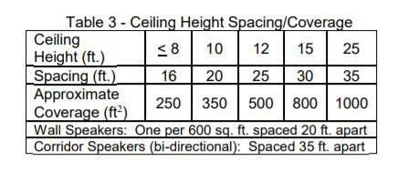
Device Alignment and Spacing
Sound moves, reflects, reverberates, and echoes.
More speakers, closer together and each at a lower volume will deliver the best clarity of sound.
Devices with strong directional sound– like horns – work best all pointed in the same direction.

Slide 34
Zoning
Which areas of the building may need to be reached independently?
Are there any events like bell schedules that need to reach some areas and not others?
Zones cannot be broken apart but can be combined together.

Slide 35


Device Choices
Traditional Square or Circular Speakers
Fit into existing spaces (measure on your walkthrough)
May have integrated volume options
Least costly, slower to install
Installation location typically fixed

Slide 36
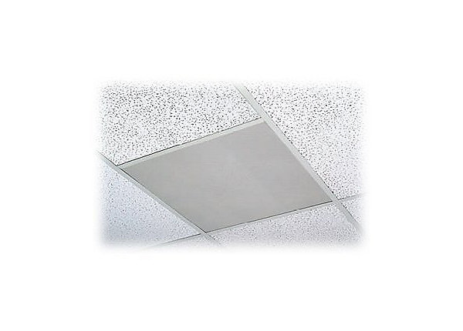
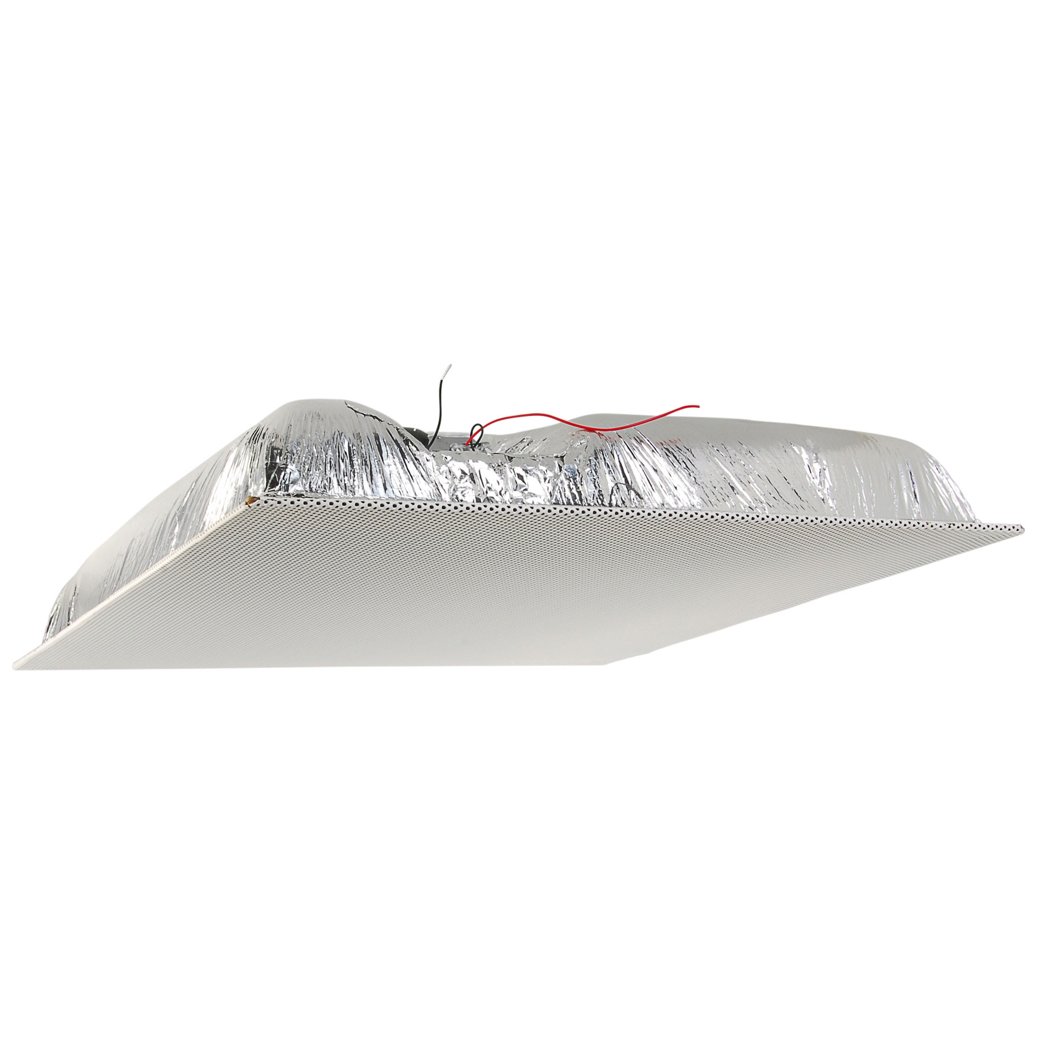
Device Choices
Lay-In Ceiling Speakers
Extremely fast installation, no mounting
Great sound coverage and projection, excellent pickup from room
Can be easily relocated, if extra cabling is left
Hands down recommendation for best overall classrooms

Slide 37
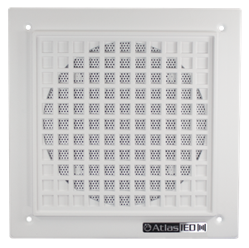

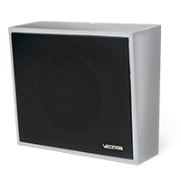
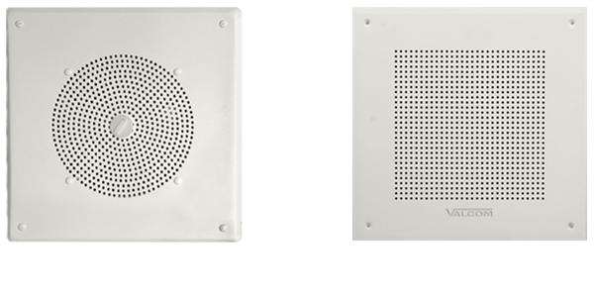
Device Choices
Wall Mounted
Wall Mounted, recessed or surface mount
Fairly directional sound
Typically a smaller driver than lay-in ceiling tile, but good coverage
Generally installed in a fixed position for its lifetime

Slide 38
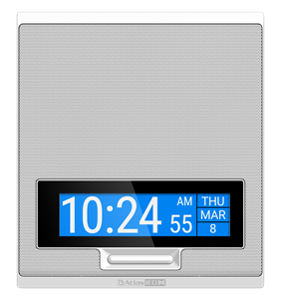
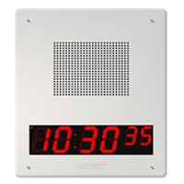

Device Choices
Speaker/Clock Combo
Wall Mounted, recessed or surface mount
One device means fewer cables and switchports for IP endpoints
Typically a smaller driver than lay-in ceiling tile, but good coverage
Generally installed in a fixed position for its lifetime

Slide 39
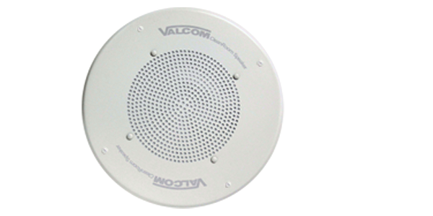
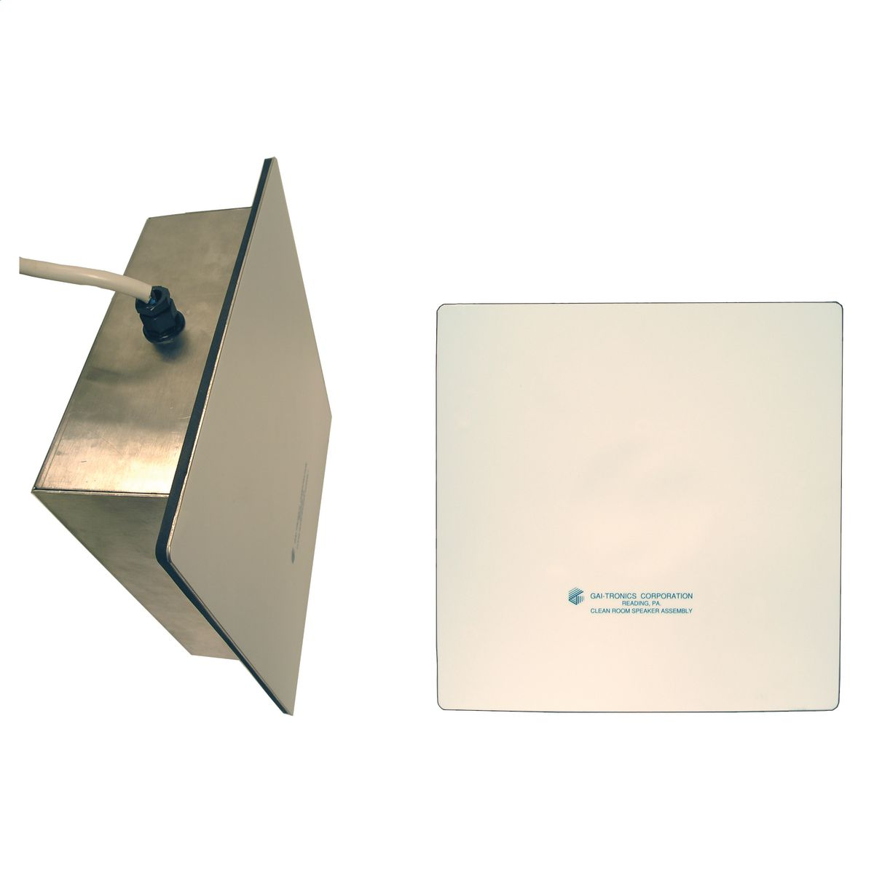
Device Choices
Clean Room
Ceiling or Wall Mount
Ideal for cafeteria areas where cooking oils in the air land on and reduce audio quality over time with traditional speakers.

Slide 40
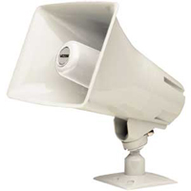
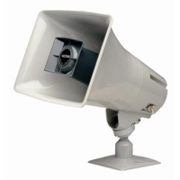
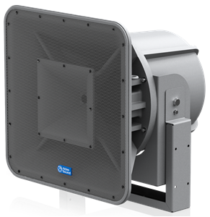
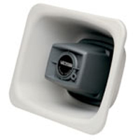
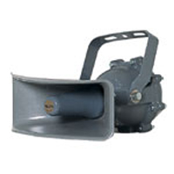
Device Choices
Horns
Wall, Beam, or Fixed Ceiling Mounted
Great sound projection over distances
Decent pickup for talkback, but not great.
Hard to Damage
All Weather

Slide 41











What Is Already In Place to Tie Into the ECS?
Fire Alarms
Security Alarms
Mass Notification Email or SMS
Panic Buttons
Door Access Systems
Phone Systems
Two-way Radios
Weather Alert Radios
IOT – Monitor Defibrillators and Fire Extinguishers
IP Video Surveillance Systems
Digital Signage Systems
Wireless Pendant Systems
Temperature / Environmental Monitoring Systems

Slide 42
Phone System Integration
If you can only initiate a page from the front office, this poses a serious bottleneck on timely communication, and a single point of failure in the event those staff aren’t able to make pages.
If it is not budgetarily feasible to address the broader system issues, investigate integration between the current paging system and current phone system.
It is important to consider with talkback capabilities that more than one page may occur at the same time. Plan for multiple connections and establish prioritization rules so the most urgent pages succeed when there is conflict.

Slide 43
Phone System Integration
Absolutely crucial to the Inform directive of ALICE training

Slide 44
Analog, IP, or Both
IP
Pros:
Improved Sound Quality
Visibility / Supervision
Granularity
Modularity
Ease of Management
Fits within IT Skillset
Enhanced Two-way Audio
Simple Integration with Visual Alerting
Analog
Pros:
Cost

Slide 45
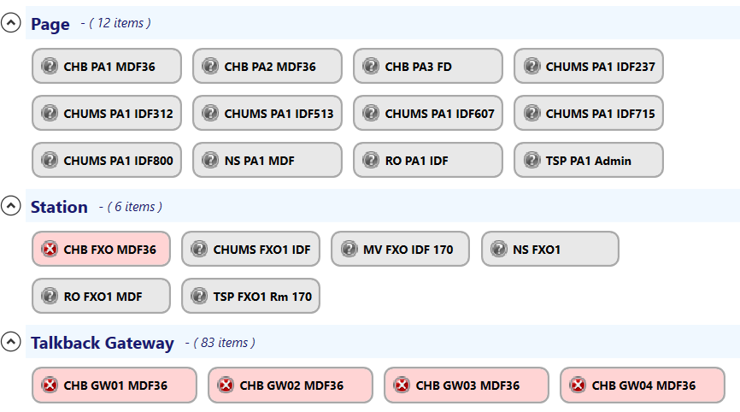

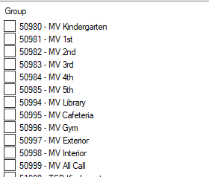
Analog, IP, or Both
Visibility –
Where are my speakers? Are they working?
Granularity –
Individual device level control of grouping, volume levels, and other settings
Modularity –
Adding or reallocating speakers is easy
Ease of Management –
IP based administration gives you full control over critical system
Fits within IT Skillset –
Installing or troubleshooting a speaker is like working with any other IP device

Slide 46
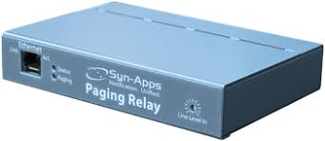
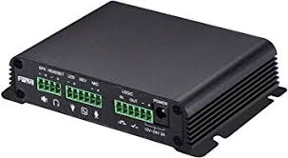



Analog, IP, or Both
IP to Analog Gateways
Hybrid approach reduces cost
Can potentially reuse existing equipment and cabling*
Sacrifices endpoint visibility and granularity, generally for one-way devices in common areas
Documentation of cabling and device connections becomes critical to later troubleshooting
*easier said than done.

Slide 47

IP Paging
Network Considerations
Most IP Paging systems use multicast to avoid excessive bandwidth during broadcasts. Multicast routing may be necessary between VLANs.
Isolate paging system in its own VLANs and limit access from student or guest accessible networks.
Prioritize VLAN via QOS like other VOIP.
Unicast to Multicast bridges can be established where multicast routing isn’t ideal or possible.

Slide 48


IP Paging
Switch Ports and Patch Panels
Keeping track of closest MDF/IDF during inventory will help
Ensure you have enough
Vertical space for equipment
Cable management
Conduit dimensions
Patch cables

Slide 49
Implementation and Testing

Slide 50

Implementation
Document, Document, Document
Make sure your device inventory and floorplan always match when changes occur
Label devices with a unique number/naming scheme in a place that is visible from the ground.
Document which ethernet run and switchport serves which IP device.
Iterative numbering for analog devices chained together in a zone.

Slide 51
Implementation
Alert
Consider utilizing panic buttons to quickly indicate school-wide that something has occurred. Position near secured ingress points and test usage regularly.
Lockdown
An ECS can provide real-time acknowledgement status information from classrooms. Talkback capabilities in each classroom are more important than ever to provide audio feedback about the situation in a room.
Inform
Initiating a page should be easy to do (but not easy to accidentally do) from anywhere within the building in order to provide continual information on the developing situation
Avoid the temptation to create commanding messaging.
Challenge
Disruptive tones and high volume, unexpected messaging can disrupt or confuse an attacker.
Evacuate
Ensure that the devices are positioned to communicate with students and staff once evacuated.

Slide 52

Testing
Emergency systems MUST be regularly tested to ensure operational during an actual emergency
Daily Bells and Announcements are the best, easiest way to ensure good system health
Utilize SNMP or other monitoring wherever possible and ensure errors and alerts will be escalated appropriately.
Always respond to reports of poor communications on these day to day operations as if they had occurred during an emergency event.

Slide 53


















When Seconds Matter:
National Weather Service and U.S. Dept. of Homeland Security
IT AS THE CORE
IP Gateway
Network
Controls
Alert Notices & Conference Bridging
Paging Amplifier
Police/Fire
Ambulance
Classroom, Common Area & Outside Speakers
Clocks, Security Cameras, Alarms & Locks
Parents
Principals
Teachers
On Premise & Off Premise Notification

Slide 54
Process
We are here!
1
2
3
4
5
Identify Mission & Initiatives
Document Current State
Develop Target State
Gap Analysis
Rough Order of Magnitude
Strategic Plan
In Person Interview
IT Synergy Survey
Architecture Review & Documentation
Data Collection
Future State Architecture Documentation
Future Educational Goals and Strategies
Current State – Future State
Execution Strategy
Strategic Plan
In Person Interviews
Electronic Survey
Educational Goals

Slide 55
Call Me
Evaluate Your Current System
Consider A Solution Design
Document Everything
Get it in the Budget
Call Me

Slide 56
Q&A

Slide 57
Thank you for joining us today
Presented by:
Erich Bacher – Engineering Services Manager
ebacher@hbs.net
920.687.4684

